Slide 1
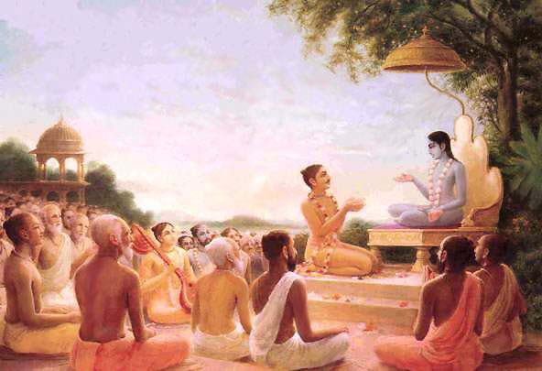
Śrīmad Bhāgavatam
1.17.38–45
Residents of Kali

Slide 2
SB 1.2.4
nārāyaṇaḿ namaskṛtya
naraḿ caiva narottamam
devīḿ sarasvatīḿ vyāsaḿ
tato jayam udīrayet

Slide 3
SB 1.2.18
naṣṭa-prāyeṣv abhadreṣu
nityaḿ bhāgavata-sevayā
bhagavaty uttama-śloke
bhaktir bhavati naiṣṭhikī

Slide 4
Outline
17.38-40: Establishing principles of religion
41: Qualifications of a Leader
42-44: Glorification of Maharaja Pariksit
Corruption free state
45: Mahārāja Parīkṣit – expert administrator
Notes:
SP purport talks about how to establish KC in this world- full of irreligious activities.
Very very practical points – gold, corruption free statefor all of us. We need to imbibe Prabupada teachings as we will be guiding people as we grow and taking responsible positions.

Slide 5
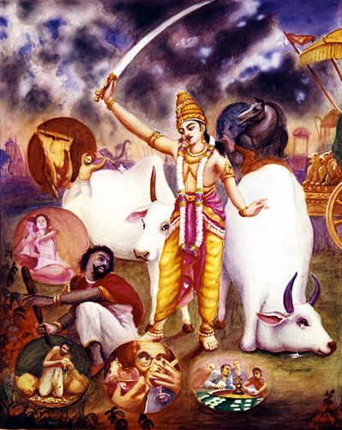
SB 1.17.38
sūta uvāca
abhyarthitas tadā tasmai
sthānāni kalaye dadau
dyūtaḿ pānaḿ striyaḥ sūnā
yatrādharmaś catur-vidhaḥ
Sūta Gosvāmī said: Mahārāja Parīkṣit, thus being petitioned by the personality of Kali, gave him permission to reside in places where gambling, drinking, prostitution and animal slaughter were performed.

Slide 6
Vedic injunctions
Pravrtti – Path of sense enjoyment- To gradually regulate activities
Nivrtti – Path of renunciation – superior
Establishing principles of religion –
Two compulsory fasting days in a month, if not more (Austerity).
Compulsory marriage(24/16). Abolish divorce act.
Giving charity to create spiritual atmosphere by preaching principles of Bhagavatam -
Karma-yoga
Regular hearing Srimad-Bhagavatam
Congregational chanting
Rendering service
Residing in spiritual atmosphere
Notes:
People in mode of ignorance – sacrifices are recommended – elevate towards path of liberation
Srimad-bhag teaches Nivrtti marg
Fasting – SP example –mayapur meeting – 500 devotees - $500/devotee – we can build temple
Don’t eat – we can build many temples.. Like eating is necessary so as association of devotees
Atmosphere saturated with God consciousness
State should be regulated by the above process

Slide 7
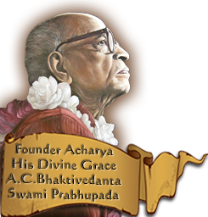
“Gambling of all description, even speculative business
enterprise, is considered to be degrading, and
when gambling is encouraged in the state, there
is a complete disappearance of truthfulness.
Allowing young boys and girls to remain unmarried
more than the above-mentioned ages and licensing
animal slaughterhouses of all description should
be at once prohibited. The flesh-eaters may be
allowed to take flesh as mentioned in the scriptures,
and not otherwise. Intoxication of all
description — even smoking cigarettes, chewing
tobacco or the drinking of tea — must be prohibited.”

Slide 8
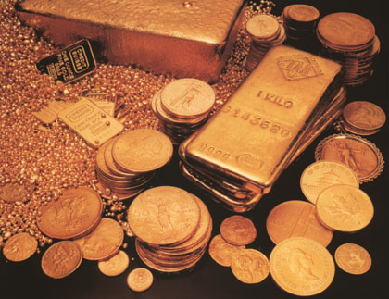
SB 1.17.39
punaś ca yācamānāya
jāta-rūpam adāt prabhuḥ
tato 'nṛtaḿ madaḿ kāmaḿ
rajo vairaḿ ca pañcamam
The personality of Kali asked for something more, and because of his begging, the King gave him permission to live where there is gold because wherever there is gold there is also falsity, intoxication, lust, envy and enmity.
Notes:
Because there were no place with four activities in maharaj pariksit’s kingdom

Slide 9
Gold encourages -
Falsity - Currency is not on par with reserved gold.
Intoxication
Prostitution – Artificial inflation of currency encourages prostitution of state economy.
Envy
Enmity
How to use Gold?
Using gold coins instead of paper currency.
Gold ornaments for women
Control by quantity, not by quantity. This will discourage lust, envy and enmity.
Notes:
Currency is issued in value beyond that of actual reserved gold
Exploitation like mortgage crisis, oil prices
Jealous…….. Hatred…….. Heard many times… after person dies.. Relatives fight to get share
SP example – limousine to pick SP.. Reporter why? They should get GOLD car. Use in service of guru and krishna

Slide 10
SB 1.17.40
amūni pañca sthānāni
hy adharma-prabhavaḥ kaliḥ
auttareyeṇa dattāni
nyavasat tan-nideśa-kṛt
Thus the personality of Kali, by the directions of Mahārāja Parīkṣit, the son of Uttarā, was allowed to live in those five places.

Slide 11
SB 1.17.41
athaitāni na seveta
bubhūṣuḥ puruṣaḥ kvacit
viśeṣato dharma-śīlo
rājā loka-patir guruḥ
Therefore, whoever desires progressive well-being, especially kings, religionists, public leaders, brāhmaṇas and sannyāsīs, should never come in contact with the four above-mentioned irreligious principles.
Notes:
Here is the criteria to test any public leaders.
four disqualifications, namely gambling, drinking, prostitution and animal slaughter.

Slide 12
Principles of irreligiosity -
brāhmaṇa -- not truthful -- all claims as abrāhmaṇa at once become null and void
sannyāsī -- illicitly connected with women -- all his claims as a sannyāsī at once become false
king and the public leader -- proud or habituated to drinking and smoking -- disqualified to discharge public welfare activities
“The four leaders of the human society, namely the
sannyāsīs, the brāhmaṇa, the king and the public leader,
must be tested crucially by their character and qualification.”
Notes:
Four leaders
Can be less qualified in academics, but it necessary to be free from irreligious principles

Slide 13
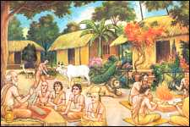
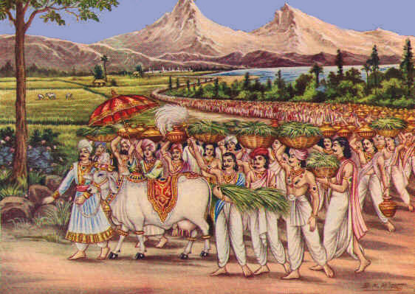
SB 1.17.42
vṛṣasya naṣṭāḿs trīn pādān
tapaḥ śaucaḿ dayām iti
pratisandadha āśvāsya
mahīḿ ca samavardhayat
Thereafter the King reestablished the lost legs of the personality of religion [the bull], and by encouraging activities he sufficiently improved the condition of the earth.
Notes:
Improving conditions – engaged people in prescribed duties
Collected all illicit gold and used in sankirtana yajna. It is not problem the gold.. Just how we use it.

Slide 14
Using one's accumulated wealth
fifty percent for the service of the Lord
twenty-five percent for the family members
twenty-five percent for personal necessities
Maximum display of human mercy
“People of the world are generally in darkness regarding
spiritual knowledge, especially in regard to the devotional
service of the Lord, and therefore to propagate the
systematic transcendental knowledge of devotional
service is the greatest mercy that one can show
in this world.”
Notes:
Pariksit collected all illicit
Spending for sankirtana-yajna

Slide 15
SB 1.17.43-44
sa eṣa etarhy adhyāsta
āsanaḿ pārthivocitam
pitāmahenopanyastaḿ
rājñāraṇyaḿ vivikṣatā
āste 'dhunā sa rājarṣiḥ
kauravendra-śriyollasan
gajāhvaye mahā-bhāgaś
cakravartī bṛhac-chravāḥ
The most fortunate Emperor Mahārāja Parīkṣit, who was entrusted with the kingdom of Hastināpura by Mahārāja Yudhiṣṭhira when he desired to retire to the forest, is now ruling the world with great success due to his being glorified by the deeds of the kings of the Kuru dynasty

Slide 16
Improving human society
Corruption free state
“Modern administrators want to banish corruption from
the state, but fools as they are, they do not know how to
do it. They want to issue licenses for gambling houses,
wine and other intoxicating drug houses, brothels,
hotel prostitution and cinema houses, and falsity in every
dealing, even in their own, and they want at the same time to
drive out corruption from the state. They want the
kingdom of God without God consciousness.”
Notes:
determination by the authorities to follow principles of Mahārāja Parīkṣit
organize society to accept the principles of religion - austerity, cleanliness, mercy and truthfulness
want the kingdom of God without God consciousness

Slide 17
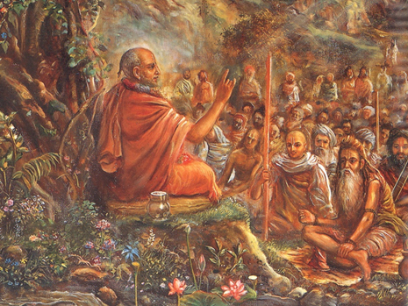
SB 1.17.45
ittham-bhūtānubhāvo 'yam
abhimanyu-suto nṛpaḥ
yasya pālayataḥ kṣauṇīḿ
yūyaḿ satrāya dīkṣitāḥ
Mahārāja Parīkṣit, the son of Abhimanyu, is so experienced that by dint of his expert administration and patronage, it has been possible for you to perform a sacrifice such as this.

Slide 18
Cooperation for common welfare
Favorable condition for spiritual advancement
State support -
Mahārāja Parīkṣit - ṛṣis of Naimiṣāraṇya
Mahārāja Aśoka - Lord Buddha
“The brāhmaṇas and the sannyāsīs are expert in the spiritual
advancement of society, whereas the kṣatriyas or the
administrators are expert in the material peace
and prosperity of human society. Both of them are
the pillars of all happiness, and therefore they are meant
for full cooperation for common welfare.”
Notes:
brāhmaṇas, sannyāsīs - expert in the spiritual advancement
kṣatriyas - expert in material peace and prosperity
Mahārāja Parīkṣit - drive away kali and made state receptive to spiritual enlightenment
Without state support - no doctrines of philosophy or religious principles can progressively advance

Slide 19
Summary
Establishing Krishna Consciousness by following the principles of Bahavatam.
Using wealth in favorable way –Sankirtan Yajna
Leaders qualifiation
Notes:
Needs of family

Slide 20
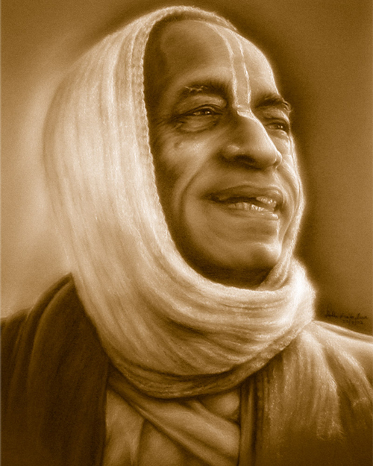
References
HH Romapada Swami Maharaj lectures

